Slide 2

Scaling to Production your Agents with Azure Landing Zone & Microsoft Foundry
14 March 2026
09:00 AM – 04:00 PM CST
Harbour Space University, Barcelona, Spain
Rubén Toribio
MVP AI

Slide 3
ENTERPRISE AI INFRASTRUCTURE FOCUS

Slide 5
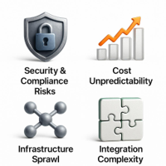
Enterprise AI: Infrastructure Needs
Foundation for Scale
AI ALZ extends Azure CAF to deliver a secure, governed, cost‑optimized platform for enterprise AI.
Security & Compliance
Eliminate public endpoints, control API keys, enforce residency, and enable full auditability.
Cost & Capacity
Gain predictability with governed model usage, quotas, and right‑sized capacity plans.
Unified Platform
Prevent silos; standardize networking, security, monitoring, and shared services for teams.
Notes:
Building enterprise AI solutions at scale requires more than deploying models—it demands a secure, governed, cost-optimized infrastructure platform that enables innovation while maintaining compliance and control. The Azure AI Landing Zone (AI ALZ) provides this foundation by extending the proven Azure Cloud Adoption Framework (CAF) landing zone pattern specifically for AI workloads. This document addresses the critical pain points organizations face when scaling AI: Security and compliance challenges: Public endpoints, API key sprawl, data residency violations, lack of audit trails. Cost unpredictability: Uncontrolled model usage, quota exhaustion, inefficient capacity planning. Infrastructure sprawl: Every team building isolated AI silos, duplicating networking/security/monitoring. Integration complexity: Connecting applications built with Agent Framework, Semantic Kernel, and Foundry Agent Service to shared infrastructure. Operational overhead: Manual deployments, inconsistent configurations, no centralized monitoring or chargeback. Image source: AI-generated

Slide 6
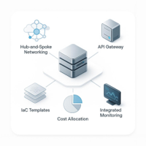
AI ALZ: SECURITY, COST, INTEGRATION
Centralized AI Platform
Reusable infra with hub–spoke networking, private endpoints, unified security policies.
Intelligent API Gateway
APIM for routing, auth, rate limits, and usage tracking across Azure OpenAI.
IaC “Vending Machine”
Bicep/Terraform templates enable self‑service deployments for app teams.
Monitoring & Governance
Azure Monitor, Defender for Cloud, and Purview for visibility and cost allocation.
Notes:
The AI ALZ solves these problems through: Centralized, reusable AI infrastructure with hub-and-spoke networking, private endpoints, and unified security policies. API Management (APIM) gateway providing intelligent routing, authentication, rate limiting, and usage tracking across multiple Azure OpenAI instances. Infrastructure-as-code (IaC) templates (Bicep/Terraform) enabling "vending machine" self-service deployment for application teams. Integrated monitoring, cost allocation, and governance through Azure Monitor, Defender for Cloud, and Microsoft Purview. Clear guidance on PTU vs pay-as-you-go deployment models based on usage patterns and cost optimization. 40–60% reduction in AI infrastructure deployment time through standardized templates. Image source: AI-generated

Slide 7
SECURITY, COMPLIANCE, AND GOVERNANCE

Slide 8
Security & Compliance Challenges
Current State
API keys in source code, public endpoints, no network isolation
Solution
Private endpoints, managed identities, Entra ID tokens, Zero Trust

Slide 9

MITIGATING SECURITY AND COMPLIANCE RISKS
1. Public endpoints, API keys
Risk of key leakage and no network isolation. AI ALZ enforces private endpoints, NSGs, Firewall, and managed identity auth.
2. Data residency, sovereignty
4. Governance
Uncontrolled token consumption (3-10x budget overages)
Infrastructure sprawl across teams
Integration complexity with multiple frameworks
Avoid processing outside required geos. AI ALZ uses Data Zone Standard/Provisioned with region constraints via Policy.
3. Missing audit and detection
AI ALZ logs every request and integrates Defender for AI, Monitor, App Insights, and Purview.
Notes:
Pain point 1: Public endpoints and API key exposure By default, Azure OpenAI endpoints are publicly accessible with API key authentication. This creates: Risk of credential leakage in source code, logs, or documentation. No network isolation—anyone with a key can call the endpoint from anywhere. Compliance violations for regulated industries (finance, healthcare, government) requiring private network access. Solution: AI ALZ enforces private endpoints for all AI services (Azure OpenAI, AI Search, Foundry Agent Service), combined with NSGs and Azure Firewall. Authentication uses managed identities and Entra ID tokens, eliminating API keys. Pain point 2: Data residency and sovereignty Global Standard deployments may process data outside the customer's specified geography, violating GDPR, local data protection laws, or internal policies. Solution: AI ALZ supports Data Zone Standard and Provisioned deployments with guaranteed data residency within EU or US zones. Architecture enforces region constraints via Azure Policy. Pain point 3: Lack of audit trails and threat detection Raw Azure OpenAI usage provides minimal visibility into who accessed what, when, and with what prompts. No detection of jailbreak attempts, data exfiltration, or unauthorized usage. Solution: AI ALZ integrates Defender for AI (threat protection), Azure Monitor (audit logs), Application Insights (request tracing), and Microsoft Purview (data governance). Every request is logged with user identity, prompt content (configurable), and response metadata. Image source: AI-generated

Slide 10
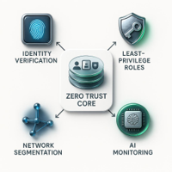
ZERO TRUST SECURITY
1. VERIFY EXPLICITLY
Authenticate via Entra ID with OAuth 2.0 and JWT tokens.
Use managed identities; no production API keys.
Enforce MFA for management plane access.
2. LEAST-PRIVILEGE ACCESS
Scope RBAC to required roles: Reader, Contributor, Owner.
Use custom roles for app teams; hub remains immutable.
Enable PIM for just-in-time administrative access.
3. ASSUME BREACH
Segment networks with NSGs; isolate APIM, AI, and apps.
Use private endpoints only; no public IPs for AI services.
Inspect egress with Azure Firewall; block unapproved models.
Defender for AI protects against injections and exfiltration.
Notes:
AI ALZ implements comprehensive Zero Trust controls: Principle 1: Verify explicitly All requests authenticated via Entra ID (OAuth 2.0 / JWT tokens). No API keys in production (use managed identities for service-to-service). MFA enforced for human users accessing management plane. Principle 2: Use least-privilege access RBAC roles scoped to minimum permissions (Reader vs Contributor vs Owner). Custom roles for application teams (can deploy to app landing zone, cannot modify hub). Privileged Identity Management (PIM) for just-in-time admin access. Principle 3: Assume breach Network segmentation via NSGs and subnets (APIM, AI services, apps isolated). Private endpoints only—no public IPs on Azure OpenAI, AI Search, Foundry. Azure Firewall inspects outbound traffic; can block unapproved model providers. Defender for AI monitors for prompt injection, jailbreak, data exfiltration. Image source: AI-generated

Slide 11
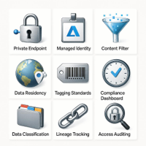
GOVERNANCE AND RESPONSIBLE AI
Network & Identity
Private endpoints only; APIM uses managed identities—no API keys.
Guardrails & Residency
Content filters required; models restricted to approved EU regions.
Tagging & Compliance
BusinessUnit, CostCenter, Environment tags; dashboard shows % compliance.
Data Governance
Classify PII/financial/health data; track lineage; audit access and auto-remediate.
Notes:
Custom policies enforced at AI Hub subscription scope: Require private endpoints: Deny creation of Azure OpenAI/AI Search with public network access enabled. Mandate managed identities: Deny APIM connections using API keys; require system/user-assigned identities. Enforce guardrails: Require all Azure OpenAI deployments to have content filter (default or custom). Data residency: Deny deployment of models in non-approved regions (e.g., only West Europe, North Europe for GDPR). Tagging standards: Require BusinessUnit, CostCenter, Environment tags on all resources. Policy compliance dashboard: Defender for Cloud Regulatory Compliance blade shows % compliance with policies. Non-compliant resources automatically flagged for remediation. Data classification: Scan storage accounts and AI Search indexes to identify PII, financial data, health records. Lineage tracking: Visualize data flow from source (Fabric, Databricks) → AI Search → Azure OpenAI → Application. Access auditing: Log who accessed what knowledge sources and when. Image source: AI-generated

Slide 12
OUTCOME
40-60% reduction in deployment time
30-50% cost savings via shared PTU capacity
Zero public endpoints and API keys
Supports 10s to 100s of AI applications

Slide 13
ARCHITECTURE AND INTEGRATION PATTERNS

Slide 14
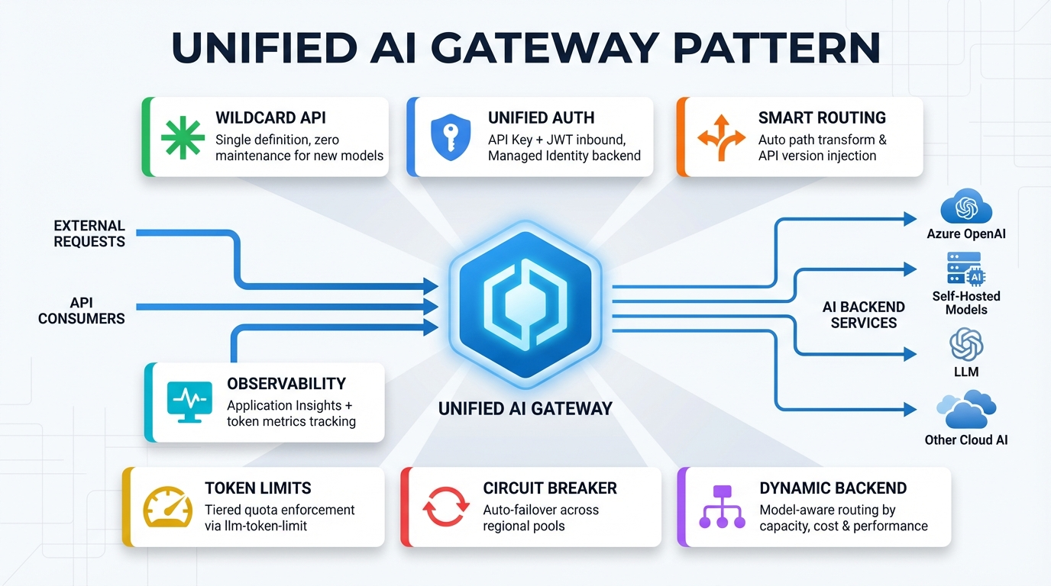
AI LANDING ZONE PRINCIPLES
Hub-and-spoke topology
Central connectivity hub with isolated application spokes.
Policy-driven governance
Azure Policy enforces baselines, naming, tagging, configurations.
Zero Trust security
No public endpoints; managed identities; least-privilege RBAC.
Infrastructure as code
Bicep/Terraform with version control and CI/CD pipelines.
Segregation of duties
Platform team runs hub and AI core; apps own their spokes.
Notes:
The AI ALZ follows Azure Cloud Adoption Framework (CAF) landing zone design principles: Hub-and-spoke topology: Centralized connectivity hub with isolated application landing zones (spokes). Policy-driven governance: Azure Policy enforces security baselines, naming conventions, tagging, and resource configurations. Zero Trust security: No public endpoints, managed identities, network isolation, least-privilege RBAC. Infrastructure as code: All resources deployed via Bicep/Terraform with version control and CI/CD pipelines. Segregation of duties: Platform team manages hub and core AI infra; application teams manage their spokes with guardrails. Image source: AI-generated

Slide 15
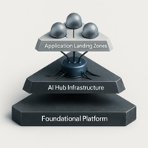
REFERENCE ARCHITECTURE AND NETWORK DESIGN
Layer 1: Platform Landing Zones
Managed by the platform team, this layer provides secure, compliant foundations, shared services, and standardized guardrails for all environments.
Layer 2: AI Hub Landing Zone
A centralized AI platform hosting core AI services, shared data, and governance. It enables reusable capabilities and secure access for multiple teams.
Layer 3: Application spoke
Isolated spoke subscriptions per app team, network-peered to the AI hub for controlled connectivity while preserving autonomy and blast-radius isolation.
Notes:
The AI ALZ consists of three logical layers: Layer 1: Platform Landing Zones (managed by platform team) Layer 2: AI Hub Landing Zone (Core AI Infrastructure) This is the centralized AI platform shared by multiple applications. Layer 3: Application Landing Zones (AI App Spokes) Each application team gets an isolated spoke subscription peered to the hub. Image source: AI-generated

Slide 16
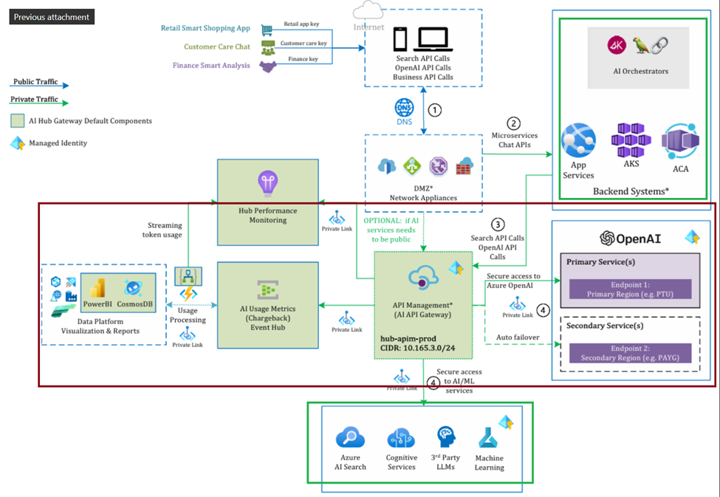
Azure Landing zone

Slide 17
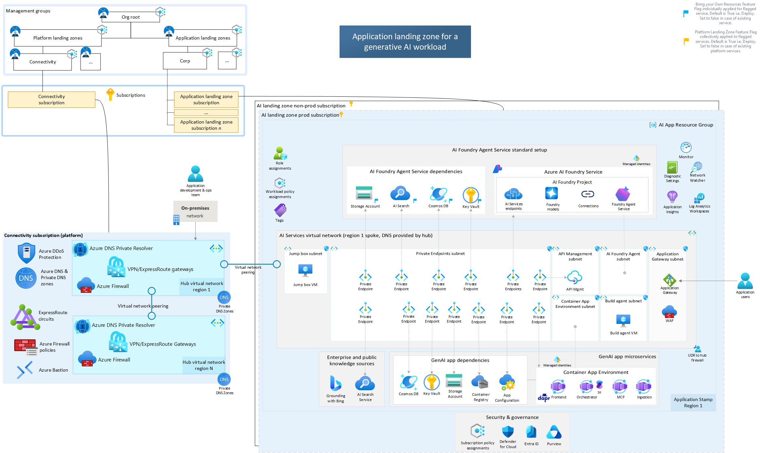

Slide 18
Provisioning
Azure Foundry Citadel
https://github.com/Azure-Samples/foundry-citadel-platform

Slide 19

PLATFORM LANDING ZONE
Connectivity: Azure Firewall, ExpressRoute, Private DNS
Management: Azure Monitor, Log Analytics, Policy
Identity: Entra ID, PIM, Conditional Access
Cost
Azure Firewall (Standard): $1,250/month
DDoS Protection (Standard): $2,944/month -> external only
Log Analytics (30GB/day): $650/month
Azure Bastion (Basic): $140/month -> external only
Defender for Cloud: $150/month
Azure Monitor: $125/month
Total: $5,259/month

Slide 20

Ai hub CORE COMPONENTS
Azure OpenAI (2+ instances with PTU + PAYG)
APIM Premium with VNET injection
Azure AI Search and Cosmos DB
Private endpoints and managed identities
Cost
API Management Premium: $2,795/month -> (vnet required) includes 1M external calls, unlimited internal
Azure OpenAI PTU (50 units): $11,600/month -> 20k users
Azure OpenAI PAYG: $350/month
Azure AI Search S1: $250/month -> optional
Cosmos DB Serverless: $300/month
Storage ADLS Gen2: $125/month
Private Endpoints (10): $73/month
Key Vault: $5/month
Total: $14,498/month

Slide 21

APPLICATION spoke
AKS, Container Apps, or App Service
Application Gateway with WAF
App-specific AI Search indexes
Observability via Application Insights
Cost
AKS (3 D4s_v5 nodes): $450/month
Application Gateway WAF v2: $300/month -> external only
Front Door Premium: $400/month -> external only
Application Insights: $325/month -> 5–20 GB/day telemetry ingestion
AI Search S1: $250/month
Cosmos DB Serverless: $125/month
Storage: $35/month
Container Registry: $5/month
Total: $1,890/month per app

Slide 22
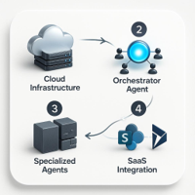
APPLICATION INTEGRATION FRAMEWORKS
When To Use Which
Agent Framework: Build new multi‑agent systems; portable; code‑first.
Semantic Kernel: Existing SK; single‑agent chat; SaaS plugins.
Foundry Agent Service: Managed infra; workflows; evals; M365 publish.
Mixing Frameworks
Foundry hosts the orchestrator entry point.
Orchestrator calls Agent Framework specialists via A2A.
Specialists use SK plugins for SharePoint/Dynamics.
AKS + APIM Pattern
Use Azure OpenAI chat client via APIM in AI Hub.
Compose workflows, evaluations, and Teams publishing in Foundry.
Notes:
When to use which: Agent Framework: Building new multi-agent systems from scratch, need portability (local dev → cloud), prefer code-first approach. Semantic Kernel: Existing SK investment, single-agent chatbots, plugins for enterprise SaaS (SharePoint, Dynamics). Foundry Agent Service: Want Azure to manage infrastructure, need workflows, evaluation pipelines, or Teams/M365 publishing. Can you mix frameworks? Yes. Example: Foundry Agent Service hosts orchestrator agent (entry point). Orchestrator calls specialized agents built with Agent Framework (via A2A protocol). Specialized agents use Semantic Kernel plugins for SharePoint/Dynamics integration. Scenario: Application built with Microsoft Agent Framework (C#) running in AKS, needs to call Azure OpenAI via APIM in AI Hub. Code pattern: using Azure.Identity;
using Microsoft.Extensions.AI;
using Microsoft.Agents.AI; // 1. Authenticate with managed identity
var credential = new DefaultAzureCredential(); // 2. Create AI project client (or directly use chat client)
var chatClient = new AzureOpenAIClient(
new Uri("https://my-apim.azure-api.net/openai/deployments/gpt-4.1/chat/completions"),
credential
); Image source: AI-generated

Slide 23
COST MODELLING OPTIMISATION

Slide 24
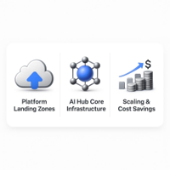
AI ALZ Cost Scaling
Category A · Platform LZ
Shared across all AI workloads; typically allocated as overhead or spread across apps.
Category B · AI Hub Core
Per hub, shared by applications; scales with workload volume and represents ~60–75% of AI-specific costs.
Scaling & Economies of Scale
Hub core monthly: 10 apps ≈ $7k; 50 ≈ $18.3k; 100 ≈ $33.8k. Per‑app cost drops: $700 → $366 → $338, demonstrating shared‑infra amortization.
Notes:
AI ALZ costs fall into three categories: Category A: Platform Landing Zones (shared across all AI workloads) These costs are typically allocated as overhead or spread across applications. Category B: AI Hub Core Infrastructure (per hub) This is the "Core AI Infra" shared by applications in that hub. These components scale with AI workload volume and represent the majority of AI-specific costs (60–75% of total AI ALZ spend). Scaling considerations: 10 applications: 1 APIM Premium unit, 50 PTUs, 1 AI Search S1 (shared indexes) = $7k/month. 50 applications: 2 APIM units ($5,500), 150 PTUs ($10,800), 2 AI Search S2 instances ($2,000) = $18.3k/month hub core. 100 applications: 3 APIM units ($8,200), 300 PTUs ($21,600), 4 AI Search S2 instances ($4,000) = $33.8k/month hub core. Per-app cost decreases with scale due to shared infrastructure amortization: 10 apps: $700/app/month (hub core only). 50 apps: $366/app/month (48% per-app savings). 100 apps: $338/app/month (52% per-app savings). This demonstrates economies of scale in centralized AI Hub model vs per-app dedicated infrastructure. Image source: AI-generated

Slide 25
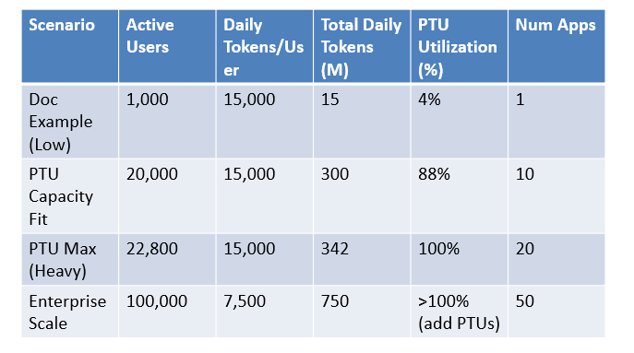
Capacity Estimates
Based on estimate patterns: 1k active users = 15M tokens/day (4% of 50 PTU capacity ~342M tokens/day)

Slide 26
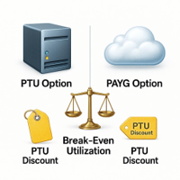
PTU VS PAYG FRAMEWORK
Formula
Monthly PTU ÷ PAYG at 100% PTU = Break-even %
Example
50 PTUs = $3,600/mo; capacity ≈ 1.5B tokens/mo
PAYG for 1.5B tokens ≈ $7,500
Break-even
$3,600 ÷ $7,500 = 48% utilization
Use >48% (>720M tokens/mo) → PTU cheaper
Annual Discount
Monthly: $72/PTU; Annual: $47/PTU (35% off)
Notes:
Formula: Monthly PTU cost ÷ Monthly PAYG cost (at 100% PTU utilization) = Break-even utilization % If your actual utilization exceeds break-even %, PTU is cheaper. Example (GPT-4.1, Data Zone Standard): 50 PTUs monthly reservation: $3,600/month 50 PTUs capacity: ~50M tokens/day (1M tokens/PTU/day rule of thumb) Monthly capacity: 50M × 30 = 1.5B tokens/month PAYG cost for 1.5B tokens: 1B input × $2.50 + 0.5B output × $10 = $7,500 Break-even utilization: $3,600 ÷ $7,500 = 48% If you use >48% of PTU capacity (>720M tokens/month), PTU saves money. If <48%, PAYG is cheaper. Annual PTU reservation discount: Monthly PTU: $72/PTU/month Annual PTU: $47/PTU/month (35% discount) Image source: AI-generated

Slide 27
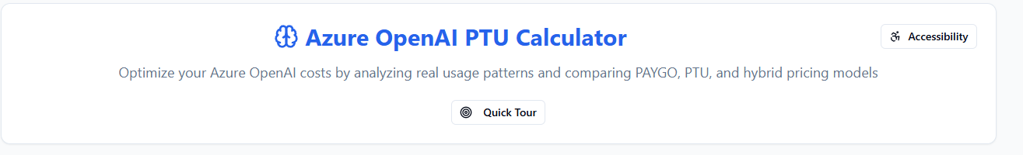
Azure OpenAI PTU Calculator
https://www.ptucalc.com/

Slide 28

Hybrid Model: PTU + PAYG
PTU for baseline capacity (p50-p75 traffic)
PAYG for burst traffic (p95-p99 spikes)
APIM routes to PTU first, failover to PAYG
Result: 50-60% cost savings vs pure PAYG

Slide 29
Zero Trust Security Principles
Verify explicitly: Entra ID OAuth tokens
Least-privilege: RBAC and custom roles
Assume breach: NSG segmentation, private endpoints
Defender for AI: threat protection

Slide 30
Managed Identity Auth Flow
Service-to-service authentication:
App requests token from Azure IMDS
Calls APIM with Bearer token
APIM validates and extracts user identity
APIM uses its identity to call Azure OpenAI

Slide 31
APIM Security Policies
JWT validation on inbound requests
Rate limiting per user and application
Token usage tracking to Event Hub
Content filtering for sensitive prompts

Slide 32

Application Framework Support
Microsoft Agent Framework (multi-agent)
Semantic Kernel (single-agent, plugins)
Foundry Agent Service (fully managed)
All connect to unified APIM gateway

Slide 33

Chargeback Architecture
Event-driven cost allocation
APIM logs requests to Event Hub
Azure Function enriches with cost data
Writes to Cosmos DB by business unit
Power BI dashboard for real-time visibility

Slide 34
Azure Policy Enforcement
Require private endpoints for all AI services
Mandate managed identities (no API keys)
Enforce content filters on deployments
Data residency constraints by region

Slide 35
MONITORING OPERATIONS MIGRATION

Slide 36
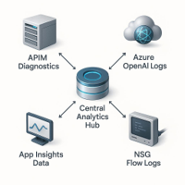
CENTRALISED MONITORING AND COST ALLOCATION
Unified Telemetry Architecture
All resources send diagnostics to a central Log Analytics workspace. Application Insights in spokes link to the same workspace for unified queries. Distributed tracing propagates correlation IDs across services.
Key Log Sources
APIM requests; Azure OpenAI inference; App Insights telemetry; NSG Flow logs; Azure Firewall outbound and threat intel.
Sample KQL Insight
Token usage by user and backend from ApiManagementGatewayLogs over the last 30 days.
Billing Challenge
How to attribute AI infrastructure costs to business units and applications for internal chargeback.
Notes:
All resources send diagnostics to centralized Log Analytics workspace (in Management subscription). Application Insights instances in app spokes linked to same workspace (unified query). Distributed tracing enabled (correlation IDs propagated across services). Key log sources: APIM: Request logs (timestamp, user, deployment, tokens, latency, status code). Azure OpenAI: Model inference logs (prompt/response optionally captured). Application Insights: App telemetry (exceptions, custom events, dependencies). NSG Flow Logs: Network traffic patterns, denied connections. Azure Firewall: Outbound connections, threat intelligence matches. Sample KQL query (token usage by user and model): ApiManagementGatewayLogs
| where TimeGenerated > ago(30d)
| extend UserId = tostring(parse_json(RequestHeaders)["Authorization"])
| extend Tokens = toint(ResponseHeaders["x-ratelimit-usage-tokens"])
| summarize TotalTokens = sum(Tokens), Requests = count() by UserId, BackendId
| order by TotalTokens desc Problem: How to attribute AI infra costs to business units/applications for internal billing? Image source: AI-generated

Slide 37
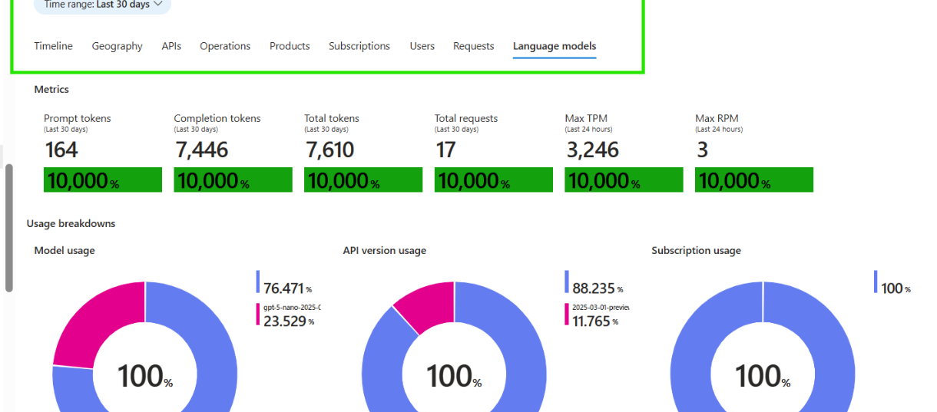
APIM DASHBOARD

Slide 38
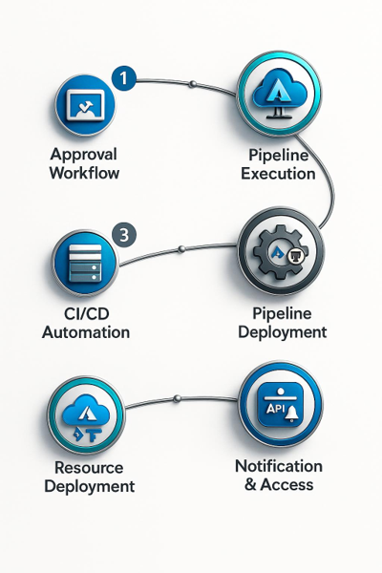
AI LANDING ZONE AUTOMATION
Accelerators (Official Repos)
Bicep and Terraform modules in Azure AI Landing Zones; Portal offers guided, slower, less-repeatable deployments.
Vending Machine Pattern (CI/CD)
Platform team curates IaC in Git; app teams submit requests with BU, env, models, quota, regions; approvals by manager and architect.
Pipelines (GitHub Actions/Azure Pipelines) generate parameters, run Bicep/Terraform with SPN, deploy in 20–40 minutes.
Teams receive APIM endpoint, managed identity GUID, and documentation upon completion.
Notes:
Azure AI Landing Zone accelerators (official Microsoft repos): Bicep: github.com/Azure/AI-Landing-Zones (Foundry Hub + Agent Landing Zones) Terraform: Same repo includes Terraform modules Portal: Azure portal UI for guided deployment (slower, less repeatable) Vending machine pattern (CI/CD automation): Platform team maintains IaC templates in Git (Azure DevOps Repos or GitHub). Application team submits request via ServiceNow, Jira, or custom portal. Request includes: business unit, environment (dev/prod), models needed, quota, regions. Approval workflow (manager + platform team architect). CI/CD pipeline (GitHub Actions or Azure Pipelines) triggers deployment. Parameters file generated from request form. Bicep/Terraform executed with service principal credentials. Resources deployed in 20–40 minutes. App team notified with APIM endpoint, managed identity GUID, documentation. Image source: AI-generated

Slide 39
Migration Phases
Phase 1
Assessment (2-4 weeks)
Phase 2
Platform deployment (4-6 weeks)
Phase 3
Pilot migration (4-6 weeks)
Phase 4
Bulk migration (8-12 weeks)

Slide 40
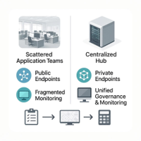
AI Landing Zone Roadmap
Current State
5–10 app teams with separate Azure OpenAI accounts.
• Public endpoints and API key exposure
• Uncontrolled token consumption (3–10× budget overages)
• Infrastructure sprawl across teams
• Integration complexity with multiple frameworks
Target State
Centralized AI Hub landing zone.
Private endpoints, managed identities, APIM gateway.
Unified monitoring, chargeback, governance.
Phase 1: 2–4 Weeks
Inventory AOAI accounts, deployments, quotas.
Map apps to business units and owners.
Estimate token usage and costs per app.
Notes:
Current state (typical before AI ALZ): 5–10 application teams each have their own Azure OpenAI accounts. Public endpoints with API keys in config files. No centralized monitoring or cost tracking. Inconsistent security policies, some apps compliant, others not. Target state: Centralized AI Hub landing zone serving all applications. Private endpoints, managed identities, APIM gateway. Unified monitoring, chargeback, and governance. Phase 1: Assessment and planning (2–4 weeks) Inventory existing Azure OpenAI accounts, deployments, quotas. Map applications to business units and owners. Estimate token usage and costs per application. Image source: AI-generated

Slide 41
Key Recommendations
Start centralized, transition to vending machine
01
Use hybrid PTU + PAYG for production
02
Enforce Zero Trust from day one
03
Implement chargeback pipeline immediately
04

Slide 43
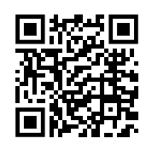
Join the Global AI Meetup

